Slide 1

February 14, 2018
Wifi:
Password: kayla1393

Slide 2

Welcome
Program Manager, Katie Feerick
kfeerick@nshc.org
(631)257-6959
www.lihealthcollab.org

Slide 3
Are You Ready, Feet?™
School #ReadyFeet Challenges
  Patchogue-Medford School District
  Bridgehampton School District
  Wyandanch’s Milton L. Olive Middle School / Cohen Children’s Medical Center grant
Libraries?
Packaging?
www.lihealthcollab.org

Slide 4
AYRF + Worksite Wellness
Cara Montesano, MS, RD, CDN, Public Health Nutrition Program Coordinator, Department of Family, Population and Preventative Medicine
www.lihealthcollab.org

Slide 8



Our Team
Community initiatives
School initiatives

Slide 9
Community Organization Initiative
Objectives
  Increase access to and consumption of healthy, affordable food and beverages
    Implementation for nutrition standards for food/beverages sold
  Increase opportunity for physical activity
    Are You Ready Feet?
    Walking maps of community organizations
    Walking challenges
Community locations
  Worksite wellness programs
  Faith-based agencies
  Libraries and other community-based organizations
  Mental health agencies
  Child care centers, pre-schools and afterschool programs

Slide 10
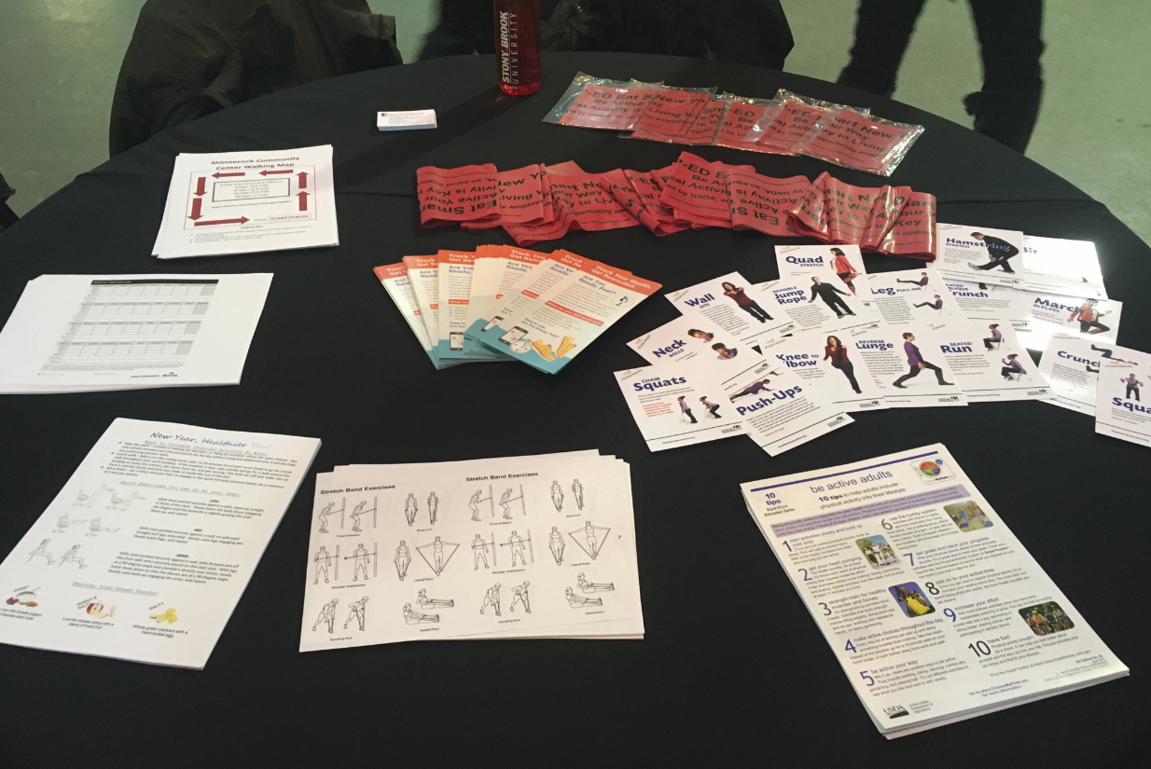
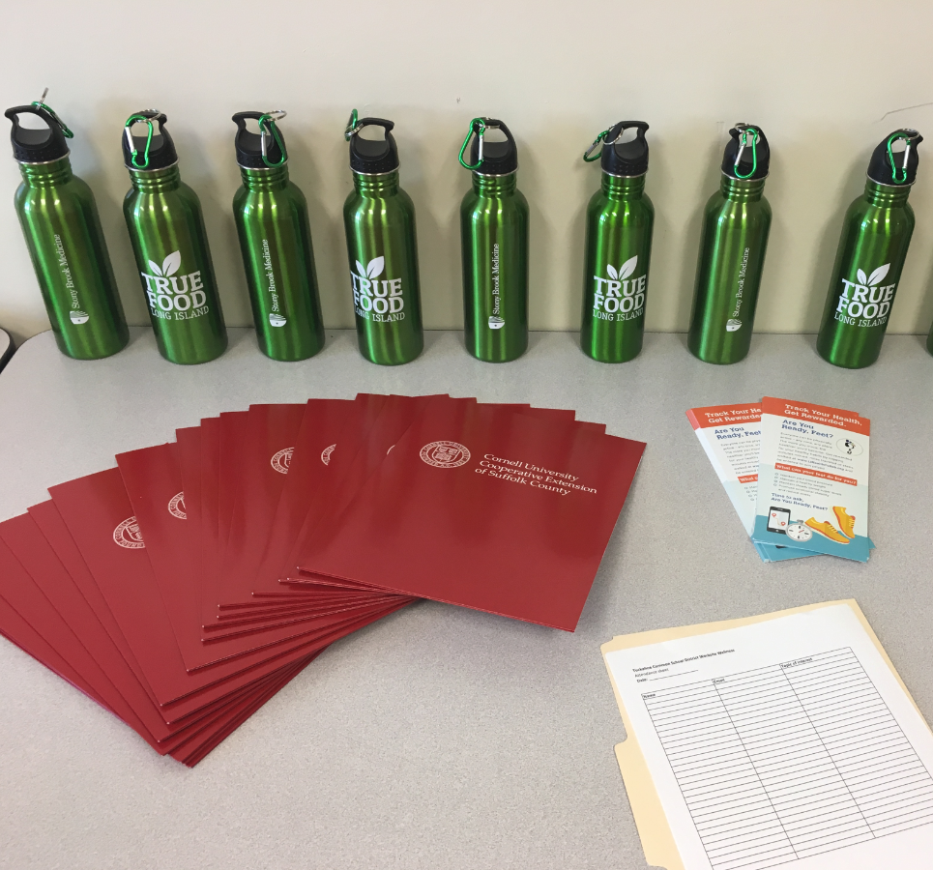
Tools to successfully encourage physical activity
Physical activity educational materials

Slide 11

Are You Ready, Feet?™

Slide 12

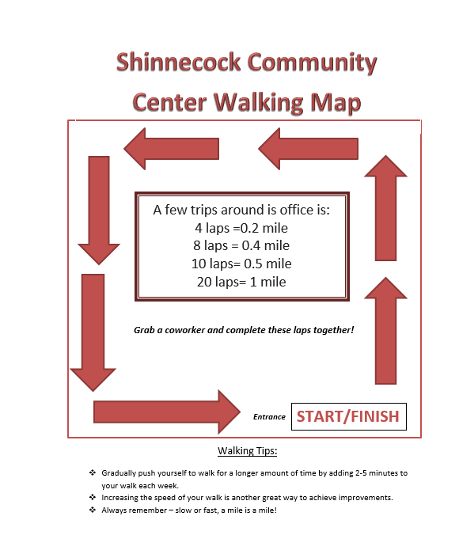
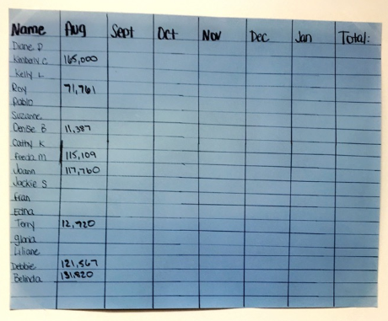
Walking Club Challenges

Slide 13
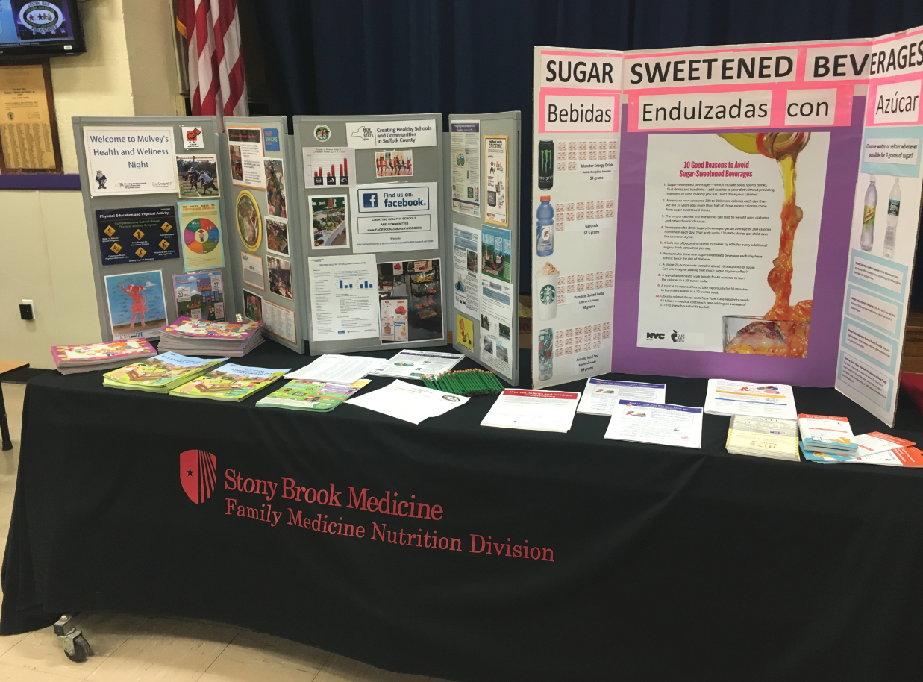
Promote
Are Your Ready Feet?
at all community events we attend:
Health & Wellness fairs
School events
Faith based organization events
Questions ?

Slide 14

Networking & Stretch Break
www.lihealthcollab.org

Slide 15
Cluster Updates
Food Cluster
Data Advisory
Physical Activity and Behavioral Health Clusters?
www.lihealthcollab.org

Slide 16
Focus Group Project
Four focus groups, two in each county
Target topic + audience + outcome
www.lihealthcollab.org

Slide 17
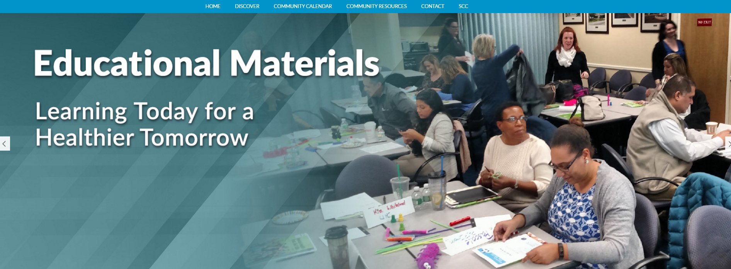
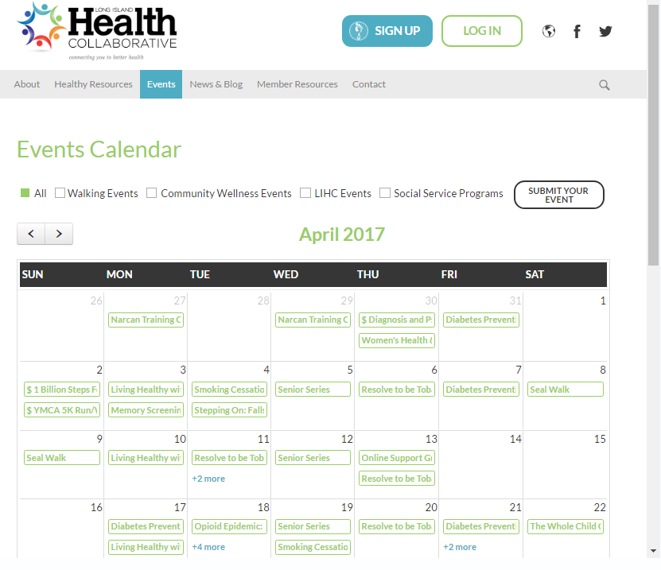
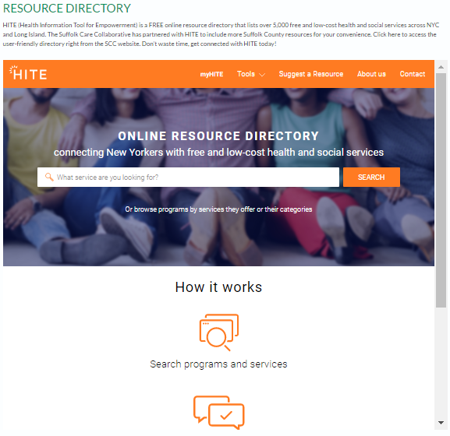
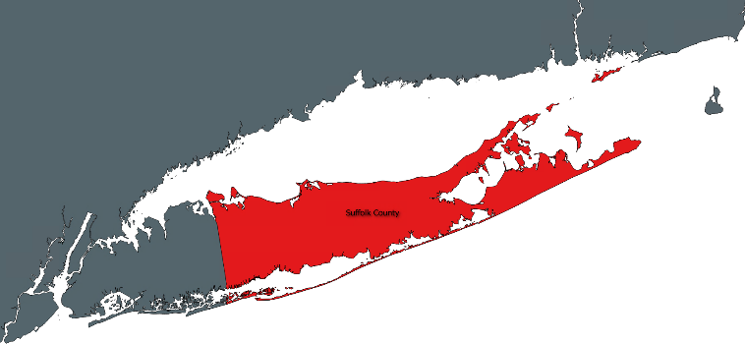
SCC updates
SCC Community Website:
www.suffolkcare.org/community
  Health Education Materials
  Community Calendar
  Health Resources
  HITE Resource Directory
1
Notes:
Our Community Engagement Website provides your organization and communities you serve a multitude of opportunities to conveniently access health education materials and connect with neighboring resources.
The community calendar provides your organization the opportunity to promote your events that encourages health and well-being. Furthermore, the calendar
The HITE Resource Directory provides all communities access to an extensive directory of community resources that serve to improve the livelihood and well-being in your own backyard. Whether that be pantries, transportation options, home care services, the options are endless. Furthermore, this directory will continue to grow as HITE is continuously seeks directly from communities and health professionals for additional resources to add.

Slide 18
SCC updates
NEW! Community Bulletin Board –CommunityEngagement@stonybrookmedicine.edu
  www.suffolkcare.org/community/bulletin-board
  Highlights ongoing neighborhood programs for:
    Trainings/Workshops
    Human Services
    Community Meetings
    Support Groups
    Community Education
    For more information, please contact:
Lyndsey Clark or Sofia Gondal, Community Engagement Liaisons
Suffolk Care Collaborative
T: 631-638-1779 (Lyndsey) / 631-638-1349 (Sofia)
E: Lyndsey.Clark@stonybrookmedicine.edu / sofia.gondal@stonybrookmedicine.edu
2

Slide 19
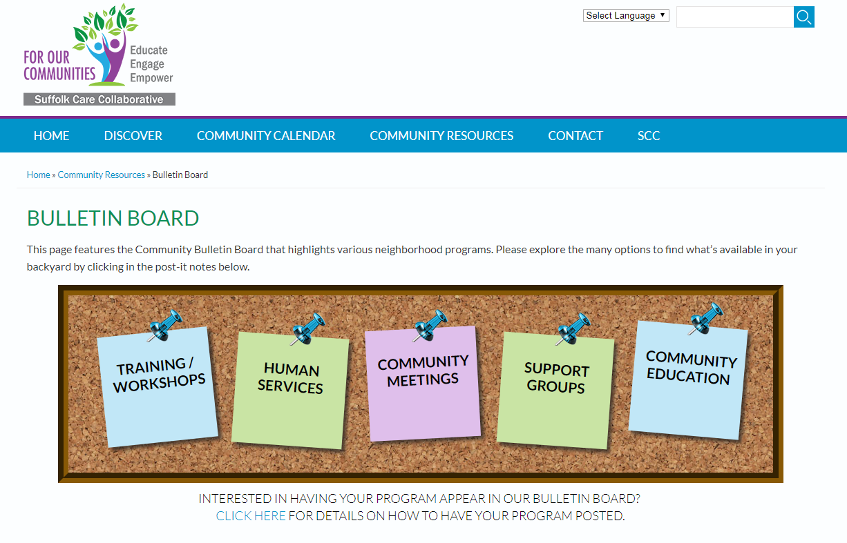
SCC updates
3

Slide 20
SCC updates
Faith Clergy Breakfast - Suffolk County Executive Steve Bellone and the Office of Minority Affairs, in collaboration with Suffolk Care Collaborative and Office of Minority Health hosted the clergy breakfast The Health Crisis in Our Communities: Opportunities to Improve Health & Wellness
DSRIP Learning Symposium – The Suffolk Care Collaborative, Nassau Queens PPS and Long Island Health Collaborative’s work in Cultural Competency and Health Literacy initiatives were presented through the “Bridging the Gap to Deliver Culturally Competent, Health Literate Care” poster
4
Notes:
The poster highlighted the innovative approach to incorporate cultural competency and health literacy to health professional throughout Queens and Long Island from by offering 2 types of trainings – full day Master Trainer and 2 hour workforce training. The innovative training approach enhanced the scalability of training across several counties and achieved outcomes which would not otherwise be attainable. This poster presentation described the training including regional need, county specific data, the collaborative experience, curriculum highlights, evaluation plans and results, and key findings.

Slide 21

  Long Island Health Collaborative
  February 14, 2018

Slide 22

NQP FOCUS
Focus Transition from
      Project Implementation →Performance Reporting
Lessons Learned - Hindsight is 20/20
Key: Data analytics
Performance Transparency utilizing NQP Website

Slide 23

CBO INNOVATION FUND
PURPOSE
Created with the goal of contracting with 33 Tier 1 CBOs ( non-Medicaid billing) to build relationships, gain knowledge of the needs of the communities and organizations that serve them, and explore opportunities to align efforts
NQP successfully attained contracting goal on December 26, 2017
Phase 1 of the Innovation Fund
  CBOs are required to hold a Health Forum that aligns with DSRIP efforts and their community needs
  CBOs that perform well during Phase 1 are then considered for Phase 2
Phase 2 basic contracts will be renewed and a smaller subset of high performing CBOs will receive larger grants

Slide 24

CONTRACTED CBOs
NQP
EMG Health Communications, Inc.
First Jamaica Community and Urban Development Corporation
Friends of the Glen Cove Youth Board, Inc.
Gateway Youth Outreach
Glory House Recovery, Inc.
Haitian American Family of Long Island, Inc.
Hempstead Hispanic Civic Association
Hispanic Brotherhood
LICADD
Long Island Coalition for the Homeless
Long Island Hispanic Pastoral Association/New Covenant Church
Make the Road New York
Mental Health Association in NYS, Inc.
New York Association of Psychiatric Rehabilitation Services, Inc.
New York Race Track Chaplaincy
Ocean Bay Community Development Corporation
Peace Valley Haven, Inc.
Queens Library Foundation, Inc.
Rockaway Waterfront Alliance
Rockaway Youth Task Force
Uniondale Community Council, Inc.
United Veteran Beacon House
Venture House
Hubs
Adelphi University Breast Cancer Program
Chinese-American Planning Council of Queens
God’s Love We Deliver
The INN
Island Harvest
Long Island Alzheimer’s Foundation
Long Island Cares
Long Island Greenmarket
NAMI
YMCA

Slide 25

UPCOMING TRAININGS
Mental Health First Aid Training
  Assist people in mental health related crisis
  Risk factors and warning signs
  Need to know how and when to help
  Learn about depression, psychosis, substance abuse and more
  Targeting 17 hotspots with 5 training dates
    1 PPS-wide
    4 located in centralized target hotspots
  Attendees receive certificate at end of the training

Slide 26
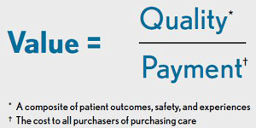
VBP TRAINING
Value-Based Payment Training Webinar for Primary Care Physicians and Mental Health/Substance Use Providers
Date: Tuesday, February 27
Time: 10:00 - 11:00 am
Location: WebEx
Topics include:
Financial basics of shared savings arrangements (FFS payment with upside only potential)
Review of VBP Contract types (TCGP, IPC-CB, bundles, special needs pops)
Understanding of incentive alignment – DSRIP/VBP, efficiency/quality
Basics of target performance setting
Elements of Efficiency and Quality adjustments
Overview of MCO/VBP contractor funds flow
Value-Based Payment Training for Tier 1 Community Based Organizations
Date: Thursday, March 1
Time: 10:00 - 11:00 am
Location: WebEx
The training will provide a basic overview of DSRIP and VBP for Tier 1 CBOs.

Slide 27
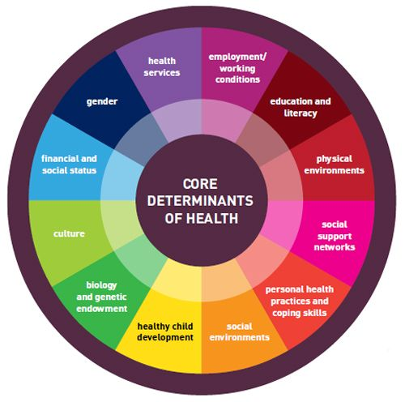
Addressing Social Determinants of Health: Housing
Addressing Social Determinants of Health: Housing
Date: Wednesday, February 28
Time: Noon - 1:00 pm
Location: Webinar
    OR
Date: Wednesday, March 7
Time: Noon - 1:00 pm
Location: Webinar
This interactive webinar will address:
How social determinants of health affect health outcomes
Housing as a local social determinant of health
How housing as a social determinant of health may cause someone to be seen as "non-adherent“
Best practices to address housing as a social determinant of health
Faculty:
Martine Hackett, Ph.D. Assistant Professor, Public and Community Health Programs, Hofstra University and the National Center for Suburban Studies, Suburban Health Equity Institute.

Slide 28

NQP WEBSITE
http://www.nqpps.org
Project Information
Project Resources
  HWAPPS Training Portal
News & Events
Career

Slide 29
Care Transitions Network
4 year project funded by CMS to reduce all-cause re-hospitalization rates for people with serious mental illness
Eligible professionals include: LCSW, Clinical Psychologists, PAs, NPs, and Physicians
www.lihealthcollab.org

Slide 30
Feedback + Adjournment
Next meeting, April 11, 2018
To register, visit
www.lihcAPRIL2018.eventbrite.com
www.lihealthcollab.org

